Slide 1
Cosets and Lagrange’s Theorem
by
Dr. T. M. Rajalaxmi
Assistant Professor
Department of Mathematics

Slide 2
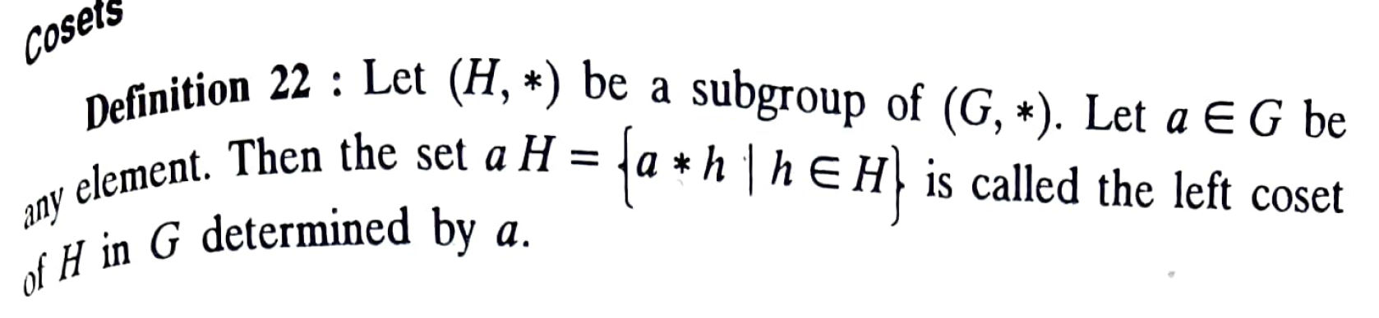
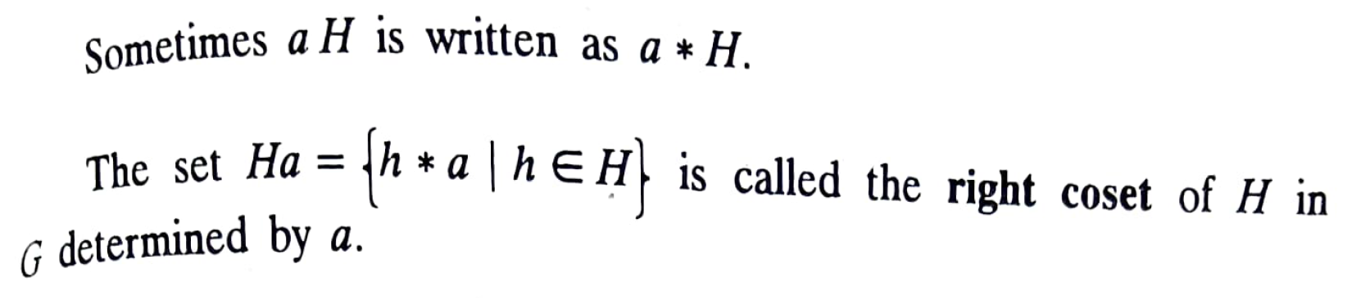
Definition - Cosets

Slide 3
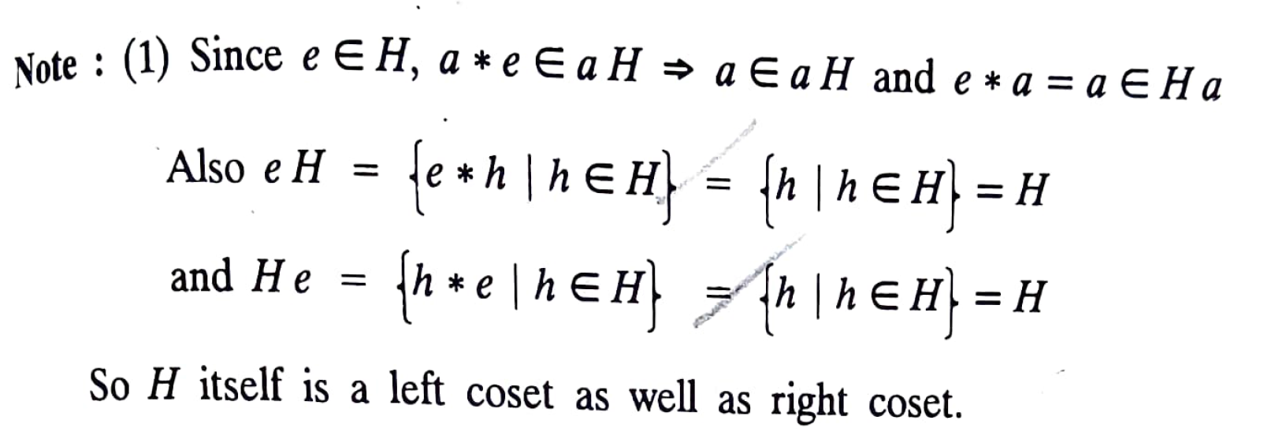
Note:

Slide 4
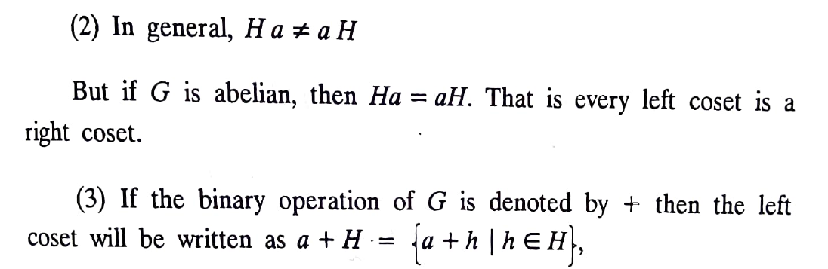
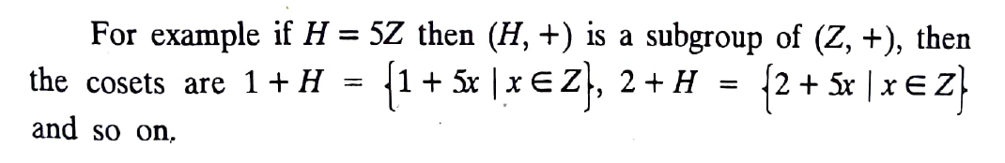
Note:

Slide 5
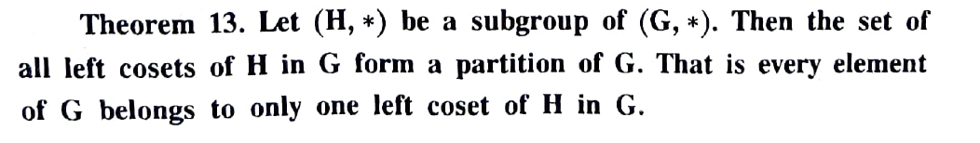
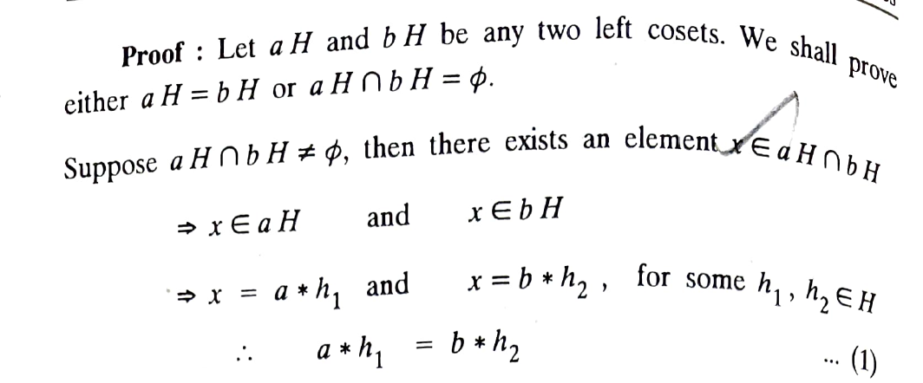
Theorem 1

Slide 6
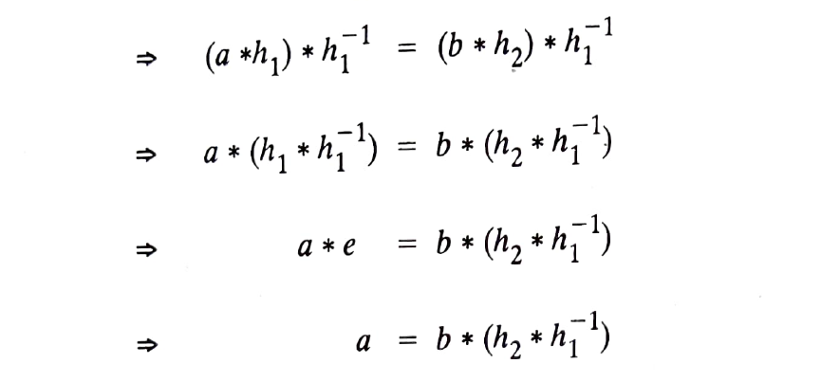
Theorem 1 cont’d

Slide 7
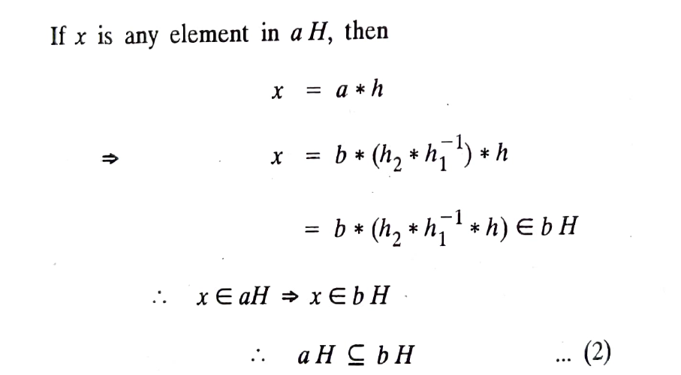
Theorem 1 cont’d

Slide 8
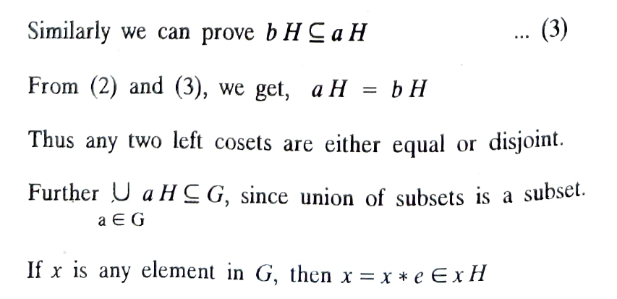
Theorem 1 cont’d

Slide 9
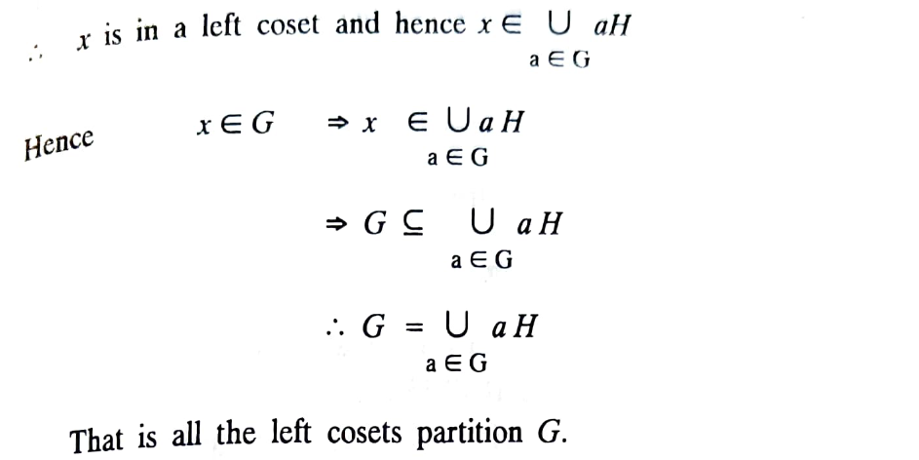
Theorem 1 cont’d

Slide 10
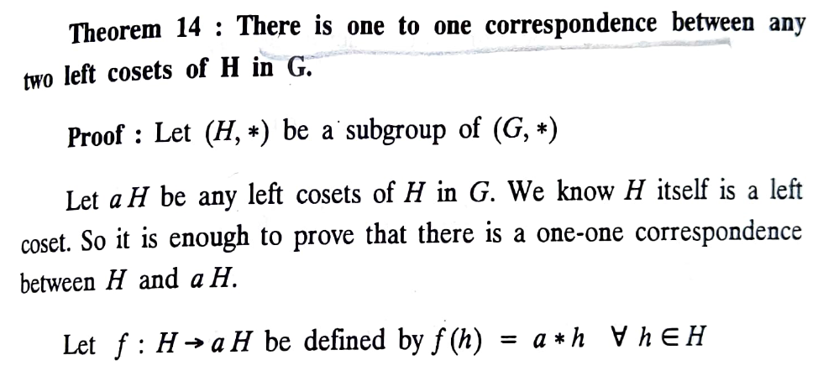
Theorem 2

Slide 11
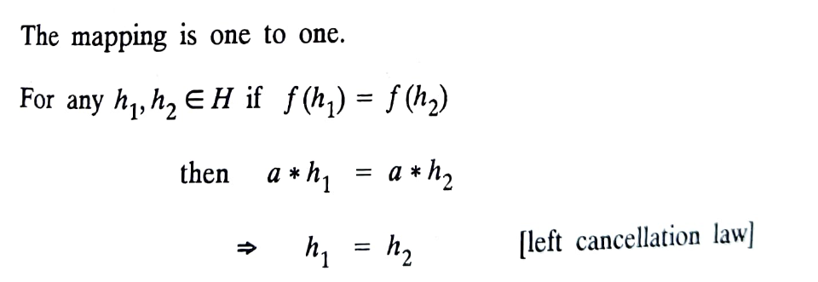
Theorem 2 cont’d

Slide 12
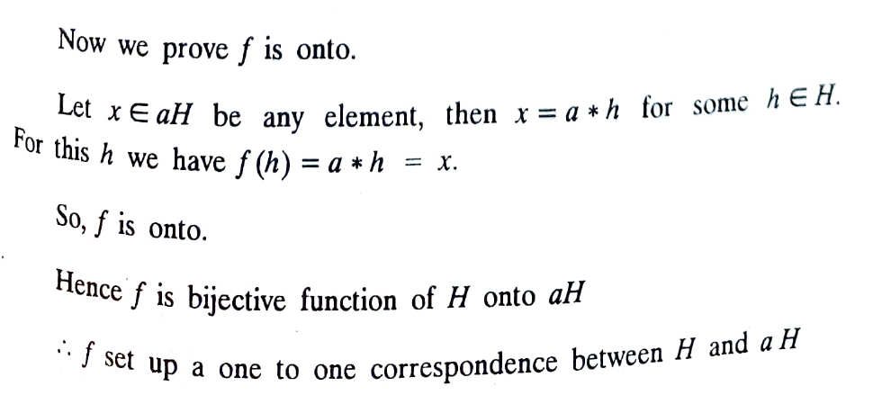
Theorem 2 cont’d
An onto function, also known as a surjective function such that
every element in the codomain (B) is mapped by at least one
element from the domain (A).

Slide 13
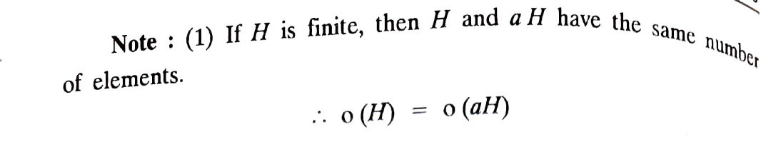
Note:

Slide 14
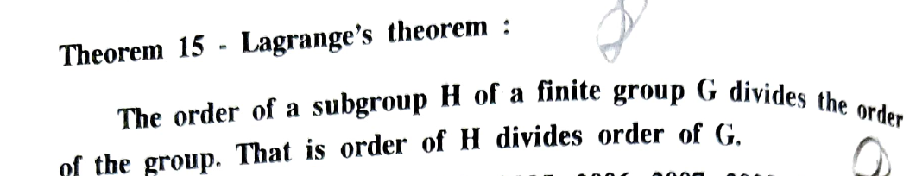
Lagrange’s Theorem

Slide 15
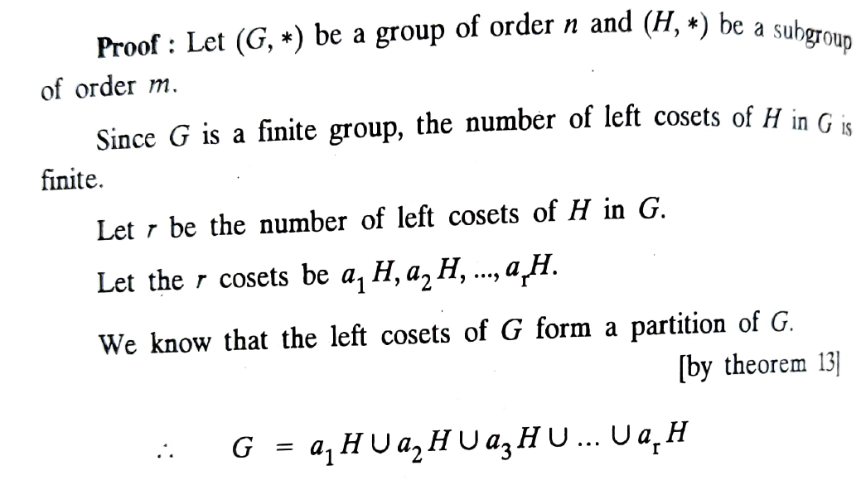
Lagrange’s Theorem cont’d

Slide 16
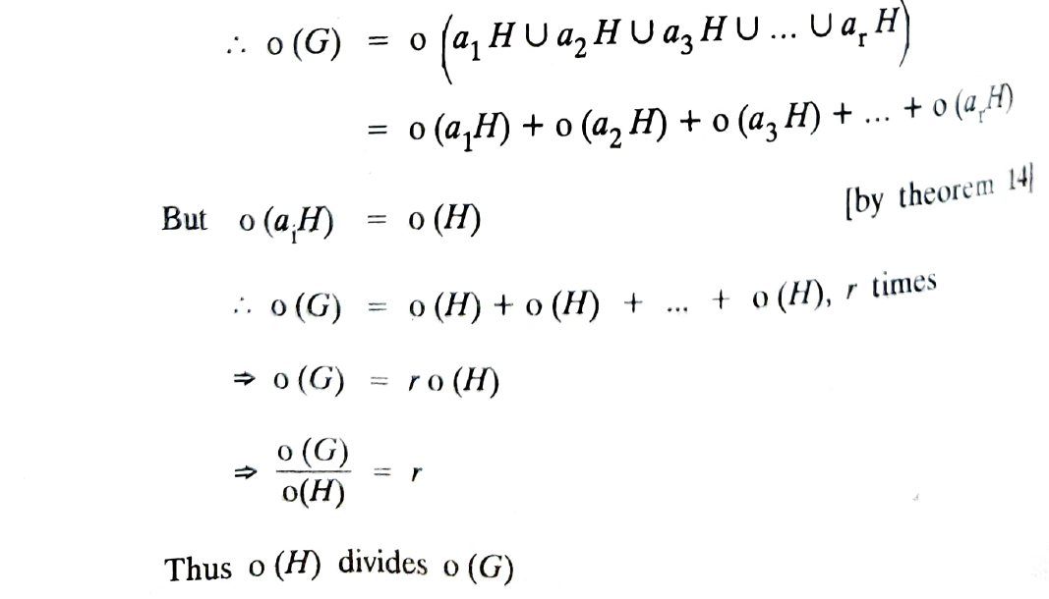
Lagrange’s Theorem cont’d

Slide 17
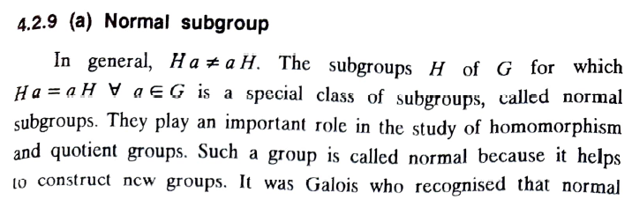
Normal Subgroup

Slide 18
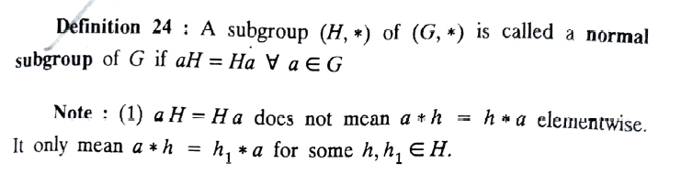
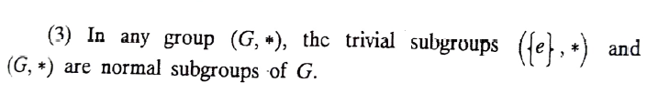
Normal Subgroup

Slide 19
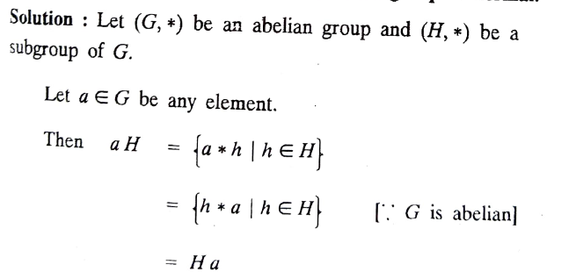
Every subgroup of an abelian group is normal

Slide 20
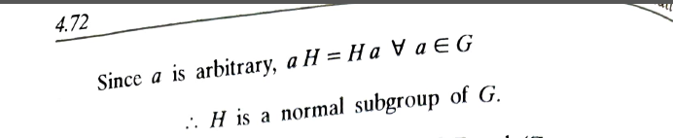
Every subgroup of an abelian group is normal

